Slide 1
Programming of smart device components
Asistentas : Simonas Česnauskas

Slide 2
Connecting to terminal servers without vpn

Slide 3
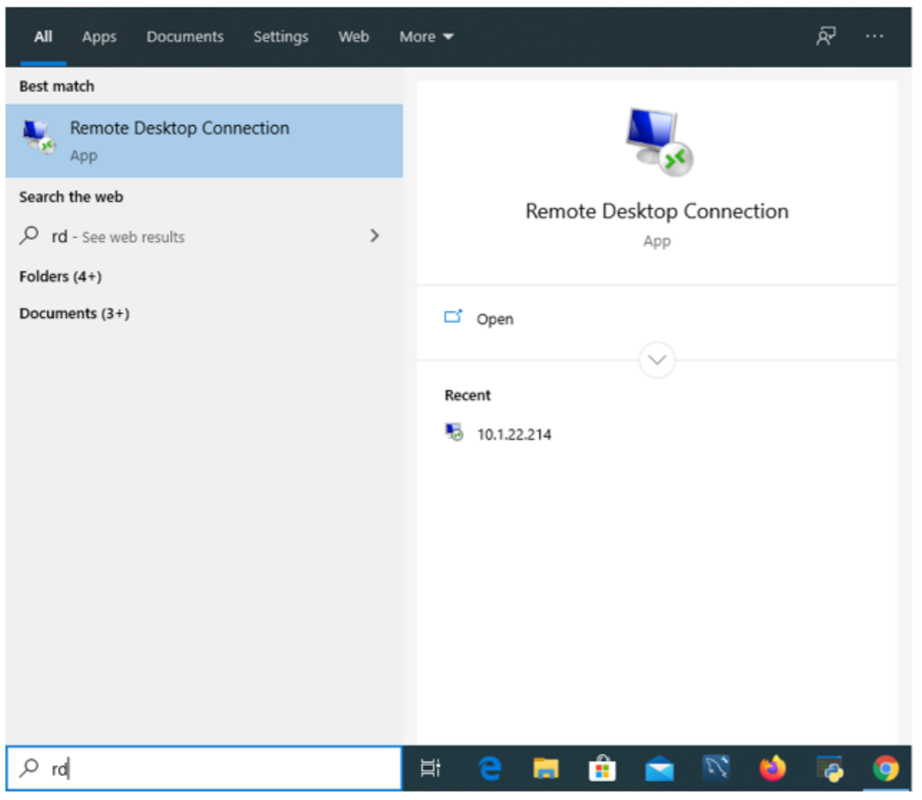
Connecting to terminal servers
We find and launch „Remote desktop connection“.

Slide 4
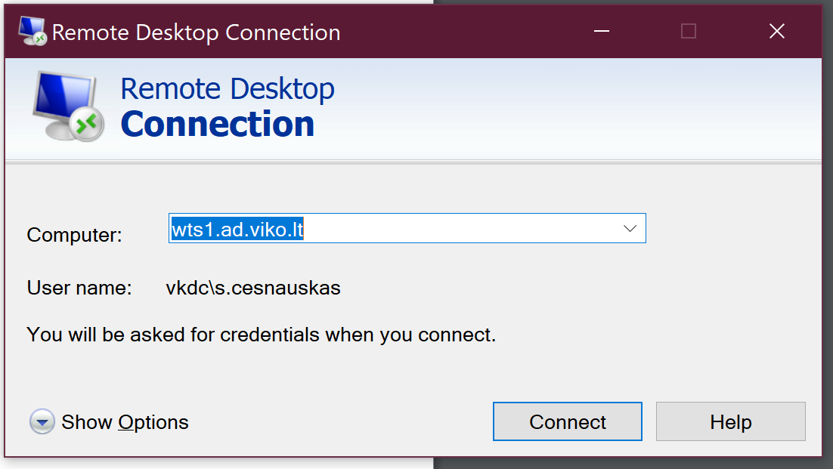
Connecting to terminal servers
Enter the name (address) of the server / computer you want to connect to.
Names of EIF terminal servers :
wts1.ad.viko.lt
wts2.ad.viko.lt

Slide 5
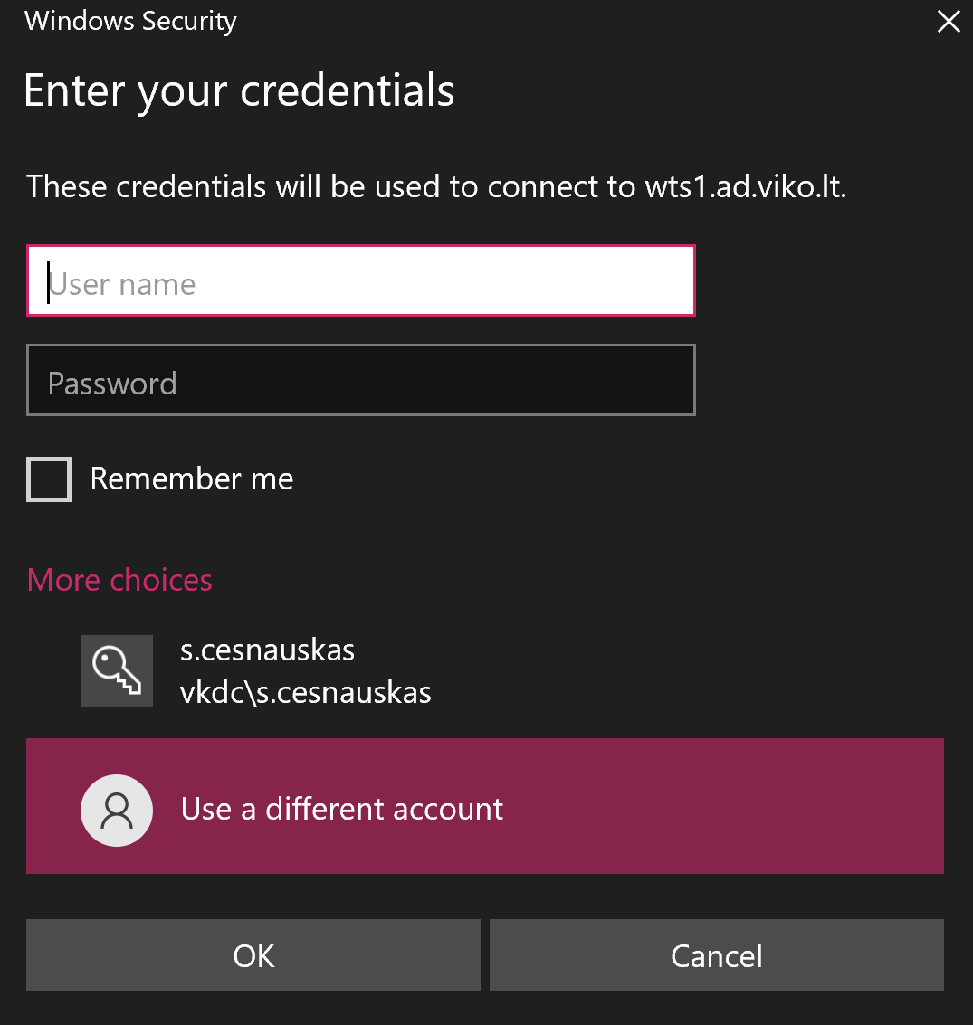
Connecting to terminal servers
We enter our login details.

Slide 6

Multisim

Slide 7
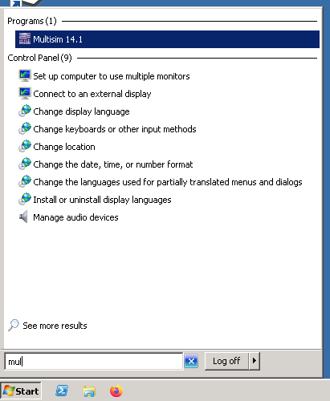
Multisim
We find multisim 14.1 using search.

Slide 8
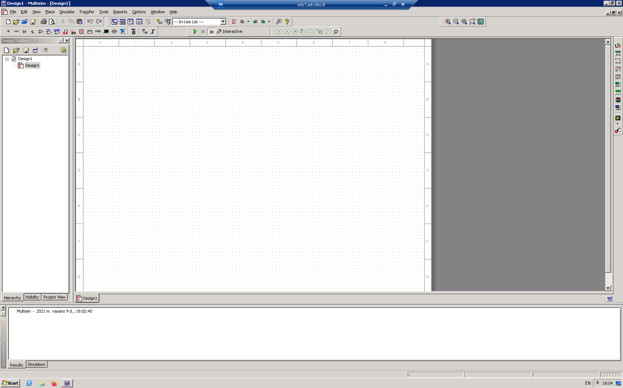
Multisim
Then we see the main window of the multisim program.

Slide 9
Main window layout
Here you will find the files you are currently working on, the files associated with it also. You can also find some settings related to the project here.

Slide 10
Main window layout
Toolbar. It contains the main necessary components, measuring devices and power supplies. Also settings related to simulation.

Slide 11
Main window layout
The remaining measuring devices, functional generators, etc.

Slide 12
Main window layout
The system status window contains the results of simulations, etc.

Slide 13
Main window layout
Simulation options

Slide 14
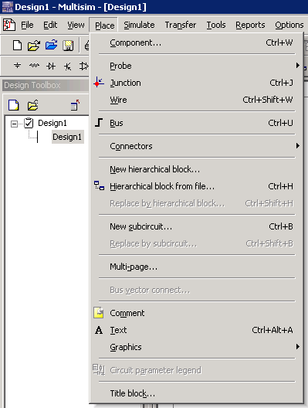
Component Library
We choose PLACE -> COMPONENT...
Or press CTR+W

Slide 15
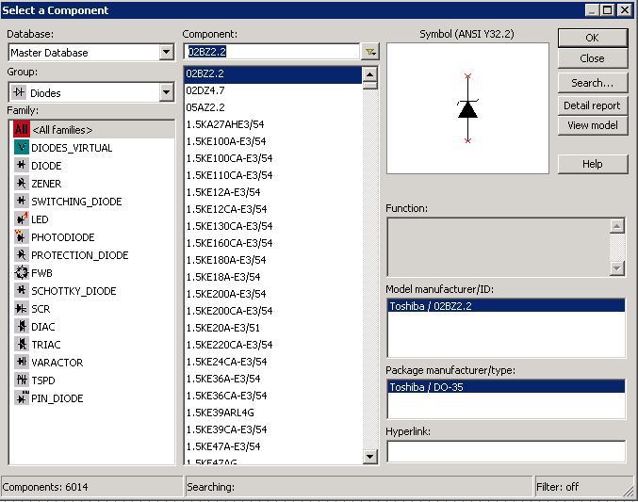
Component Library

Slide 16
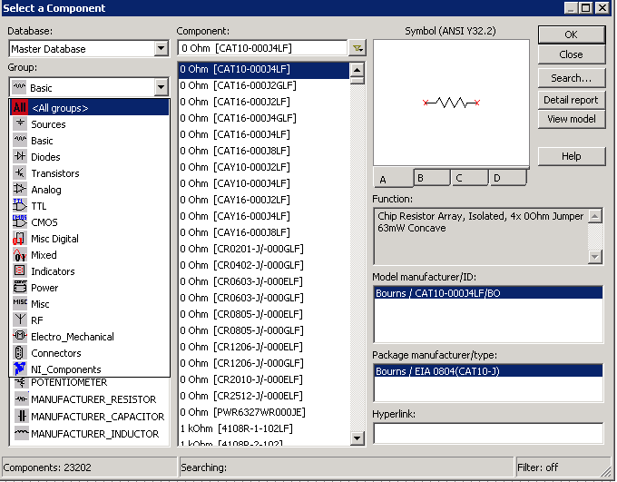
Component Library
Component groups by purpose

Slide 17
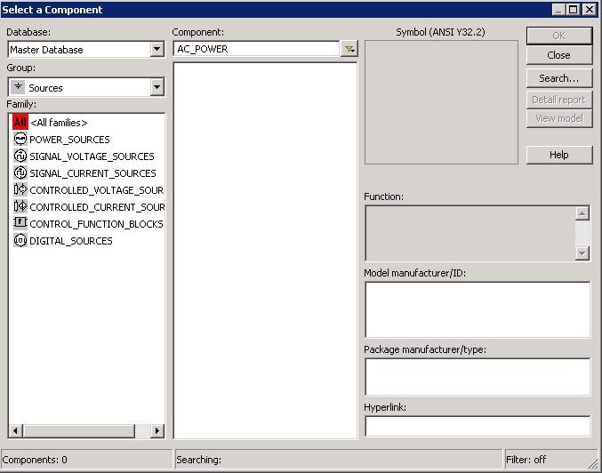
Component Library
List of subgroups

Slide 18
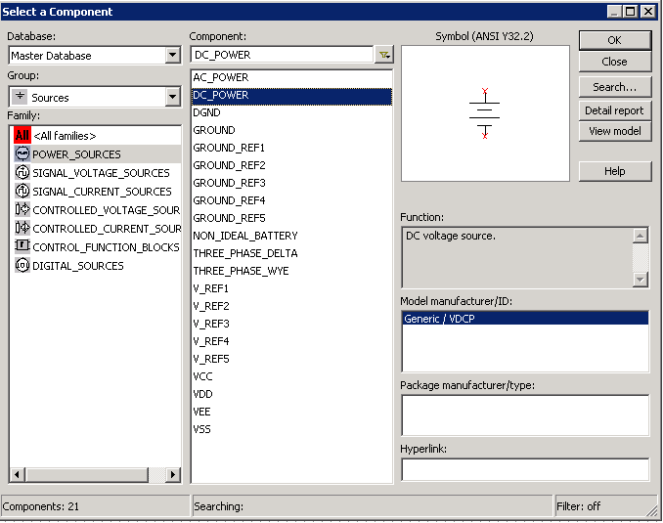
Component Library
Specific components
which we need to choose

Slide 19
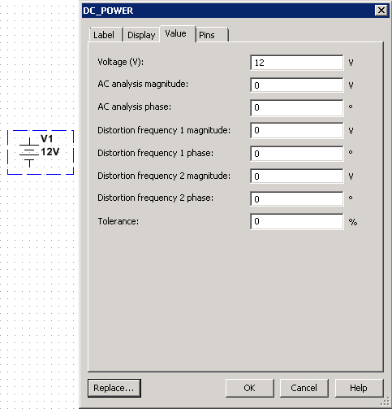
Component Library
By double-clicking on the placed component, we can modify its parameters. In this case, since we have a DC power supply, the most important thing for us to change is its voltage.

Slide 20
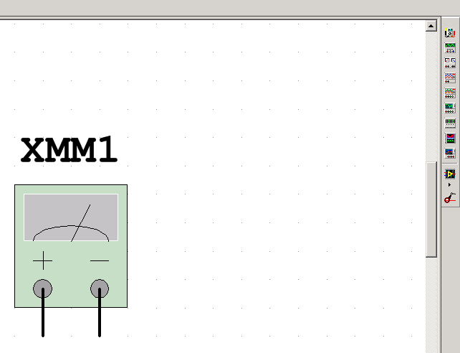
Measuring instruments
To measure the basic parameters of the circuit, we choose the Multimeter measuring device. Which we can use to measure voltage, current and resistance, both AC and DC.

Slide 21
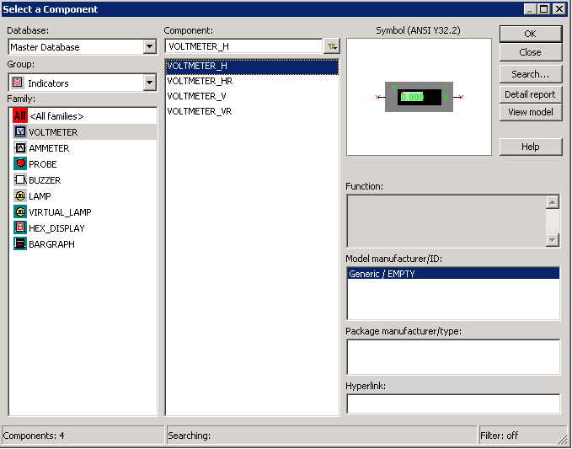
Measuring instruments
The voltmeter is connected to the circuit in parallel.

Slide 22
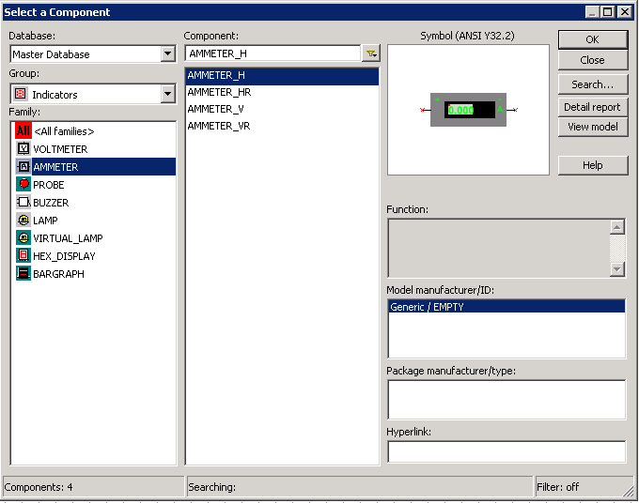
Measuring instruments
The ammeter is connected to the circuit in series.

Slide 23
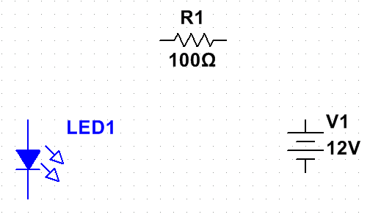
Scheme assembly
Let's assemble the simplest circuit with a resistor and a red LED. We first compile the components from the library in the main window.

Slide 24
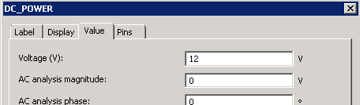
Scheme assembly
Because the value of the resistor depends on the supply voltage and the voltage required for the LED. We choose that our supply voltage will be 5V. And we change it in the program by double-clicking on the component.

Slide 25
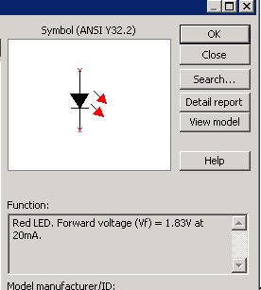
Scheme assembly
What voltage is required for the LED we can see when we select it from the component library.

Slide 26
Scheme assembly
Once we know these values according to the law of ohm, we can calculate what value the resistor will be used.
5 – 1.83 = 3.17V.
R = V / I; R = 3.17V / 0.005A = 634 ohms.

Slide 27
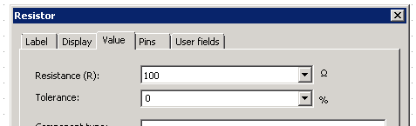
Scheme assembly
Then by double-clicking on the resistor in the multisim program, we can change its value to the required one.

Slide 28
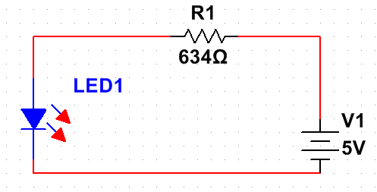
Scheme assembly
After all the changes, we finally have a schematic with the required components.
To connect them, click on the component contact and then click on where we want to connect it.
The positive contact of the power supply is the one with the longer line.

Slide 29
Measurements
Voltage drop on the resistor.
Voltage drop on the LED.
Power supply voltage check.
Resistor resistance measurement.
Circuit current consumption measurement.

Slide 30
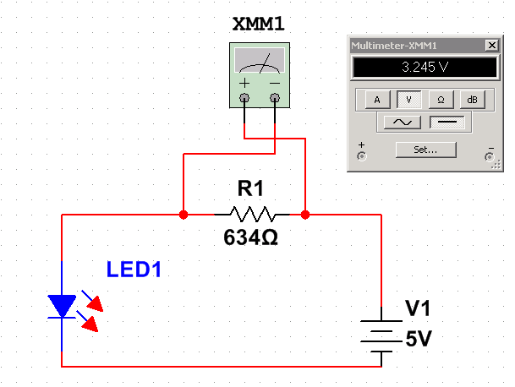
Voltage drop on the resistor

Slide 31
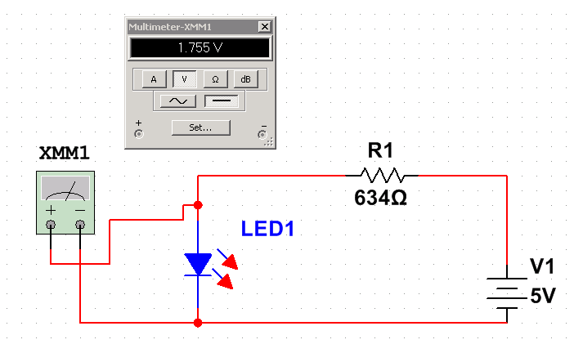
Voltage drop on the LED

Slide 32
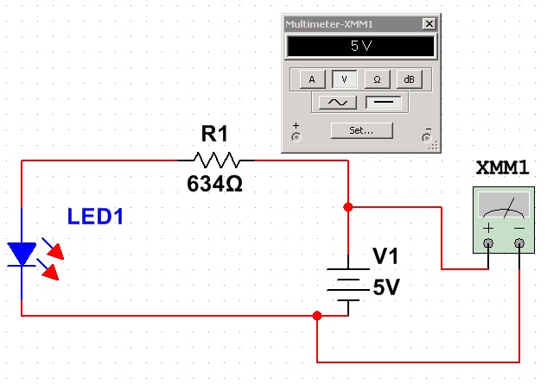
Power supply voltage check

Slide 33
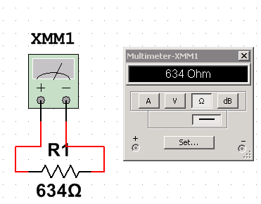
Resistor resistance measurement

Slide 34
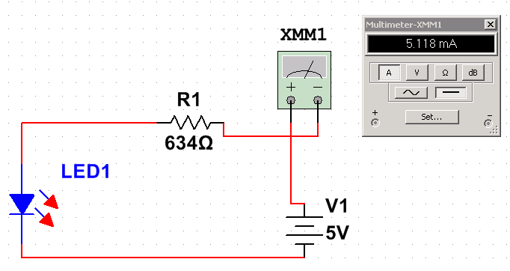
Circuit current consumption measurement

Slide 35
Goodbye

